Slide 1


Email Slicer
Instructor: Prof. Neha Shukla
Group- CSEPY004
Name-Aman kumar Thakur
Roll No.-1900290100020

Slide 2

Introduction
Requirements
Functions
Algorithm
Code
Output
Future works
Conclusion
Contents:

Slide 3

What is Email Slicer?:
Email slicer is a handy program to get the username and domain name from an email address, in which it takes an email address and just split the email address with reference of “@” and show us the domain name and user name. It’s a technical project which helps in filtering emails and make ease to send a message to the user.

Slide 4
Requirements:
Basic knowledge of Python 3 or above
Installed Python compiler or Text editors like Pycharm, Atom, Sublime etc. to run the program.

Slide 5
Functions used:
Strip() –
Strip() is an inbuilt function in Python programming language that returns a copy of the string with both leading and trailing characters removed(based on the string argument passed).
The strip() function returns a copy of the string with both leading and trailing characters removed.
Syntax
String.strip([chars])

Slide 6
2. Index() -
Index() is an inbuilt function in Python, which searches for given element from start of the list and returns the lowest index where the element appears.
The index() function returns lowest index where the element appears.
Syntax
List_name.index(element, start, end)

Slide 7
3. Slice() -
A slice object is used to specify how to slice a sequence. We can specify where to start slicing and where to end. We can also specify the step, which allows you to e.g. slice only every other item.
The slice() function returns a slice object.
Syntax
Slice(start,end,step)

Slide 8
4. Format() -
Format() is one of the string formatting methods in Python, which allows multiple substitutions and value Formatting. This method lets us concatenate elements within a string through positional formatting.
For matter work by putting in one or more replacement fields and placeholders defined by a pair of curly braces {} into a string and calling the str.format(). The value we wish to put into the placeholders and concatenate with the string passed as parameters into the format function.
It returns a formatted string with the value passed as parameter in the placeholder position.
Syntax
{}.format(value)

Slide 9
It asks for the email address
Enter the email address
It strip the email address which removes characters from both left and right based on the argument.
It search for the index of “@” in the string by using index() function which returns the index of the specified element in the list.
It will slice out the whole characters before the index of “@” which gives us username.
It will slice out the whole characters after the index of “@” which gives us domain name.
It will print the username and domain name of the email address.
How it works?:

Slide 10
Code:
# Get user email address
email = input("What is your email address?: ")
email=email.strip()
a=email.index(“@”)
#Slice out the user name
user_name = email[:a]
# Slice the domain name
domain_name = email[a+1:]
# Format message
output = "Your username is '{}' and your domain name is '{}'".format(user_name,domain_name)
# Display output message
print(output)

Slide 11
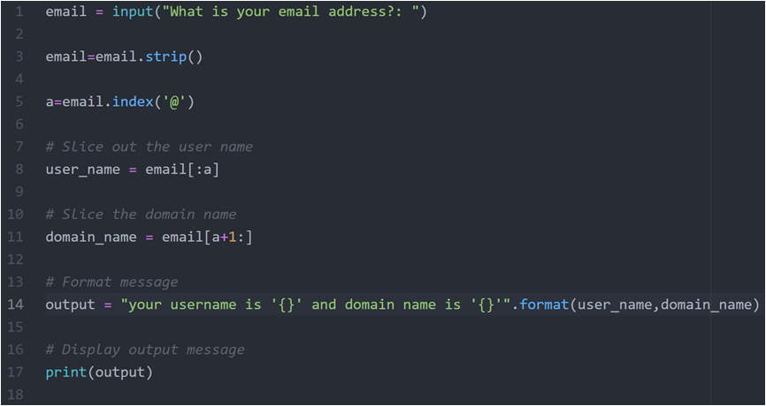
Code snapshot:

Slide 12
Outputs:
What is your email address?:
example121@gmail.com
your username is ‘example121’ and domain name is ‘gmail.com’

Slide 13
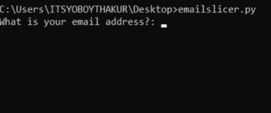
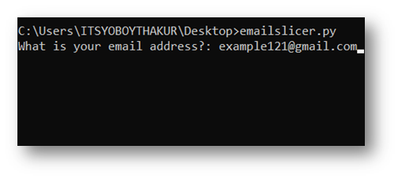
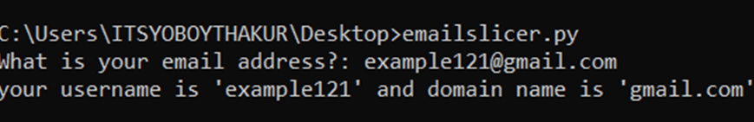
Output snapshot:

Slide 14
Future Works:
It can be used as a filter which will separate the user amongst all email addresses and also after some implementations, it can also be customized to text that user.
It will also help huge working IT industries to differentiate mails by filtering the domain name and username.

Slide 15

Conclusion:
This is a convenient program that has a lot of use in future.
With the help of this project, we can customize the application and send a message to the host with this information.
¨Firstly we took email address as input then after stripping the text, indexing the position of “@”, slicing the characters before and after index no. of “@”, we got our username and domain name.

Slide 16
Thank You

